Slide 1

Human Resources Analysis Predict Attrition
Enterprise Data Science Bootcamp
m20191415 Carolina Nascimento Alves | m20190849 Diana Ferreira m20191417 Eliana Sobral | m20190792 Miguel Pereira

Slide 2




Human Resources Analytics
Without data, you’re just another person with an opinion… (W. Edwards Deming)
Human Resources analytics is a data-driven approach toward Human Resources Management where Human Resources data is collected and analyzed in order to improve an organization’s workforce performance
This analysis is a measured evidence of how Human Resources initiatives are contributing to the organization’s goals and strategies
Analytics helps companies track absenteeism, turnover, burnout, performance and much more
Human Resources decisions are no longer based on gut feeling
Operational
Human Resources
Strategic
Human Resources
Data-driven
Human Resources
Make better decisions using data
Create a business case for HR interventions
Test the effectiveness of these interventions
Move from an operational partner to a tactical, or even strategic partner
1900s
2000s
Now

Slide 3






Methodology
Data analysis were performed using CRISP-DM (Cross-Industry Standard Process for Data Mining) a structured approach to planning a data mining project such as this one
Data Preparation
Few columns without meaningful information were dropped
Data quality leveled up to the requirements of the selected analysis techniques
Categorical variables were transformed into dummies, to be used in further analysis / modelling
New variables were created
Present all the main findings and conclusions to the key stakeholders
Next steps
Data Understanding
Data Exploration
Predictive Modelling
Collect all necessary data for the project
Form hypotheses about the defined problem by visually analyzing the data
Train and fine tune the predictive models selected. Evaluate their performance
1
2
3a
3b
3c
4
5
Business Understanding
Collect initial data
Describe, explore data
Verify data quality
Data Cleaning
The dataset was firstly analyzed in Power BI to gather insights and to better understand the dataset
Feature Engineering
Select predictive model
Generate test design
Build and fine tune the model
Evaluate results
Data Visualization
Ask relevant questions and define objectives for the problem
Fix the inconsistencies within the data and handle possible missing values
Select important features and construct more meaningful ones using raw data
Communicate the findings with key stakeholders using interactive visualizations

Slide 4

1
Business Understanding
Main Goal - predict the attrition of an employee, i.e. the probability of an employee with certain characteristics stay or quit his/her current job in the company
How high is the annual employee turnover?
How much of the company employee turnover consists of regretted loss?
Do you know which employees will be the most likely to leave the company?
What measures can we develop to avoid attrition?

Slide 5








2
Data Understanding
Number of Records – 1470
Data - The dataset was provided by BI4All – Turning Data Into Insights, with information from all employees that have been working at a specific company within a time period
Drawbacks
The dataset is lacking information that would be important to the analysis in place:
Chronologic data >> Timestamp of the main events
Hierarchical structure of the company
Main drive for attrition
Benchmarking within companies in the same industry
Age
Gender
Marital Status
Education
Education Field
Demographics
Daily Rate
Hourly Rate
Monthly Rate
Monthly Income
Percent Salary Hike
Stock Option Level
Income / Payment
Performance Rating
Performance
Job Involvement
Job Satisfaction
Relationship Satisfaction
Environment Satisfaction
Working Life Balance
Engagement
Distance from Home
Business Travel
Standard Hours
Department
Job Level
Job Role
Training Times Last Year
Years at Company
Years In Current Role
Years Since Last Promotion
Years with Current Manager
Total Working Years
Number of Companies Worked
Job / Professional Life

Slide 6





3
Data Preparation
Pre-processing raw data into a form that can readily and accurately be analyzed and therefore gather insights and to better understand the dataset:
Data Cleaning
The columns dropped:
Data Exploration
Over18
(only with ‘Yes’)
EmployeeCount
(only with ‘1’)
StandardHours
(only with ’80’)
Feature Engineering
Age_Entry
(into the company)
IncRateRatio
(income to daily rate ratio)
IncMonthlyRate
(income to monthly rate ratio)
Flag_1sJob
(Indicates if it is first job)
Perc_lftm_company
(% work lifetime in the company)
Age_Workforce
(start of professional life)
IncYearsRatio
(income to years at company ratio)
HrDailyRate
(hourly to daily rate ratio)
Avg_prev_worktime
(average time worked at other companies)
MonthlyRate
(monthly to hourly rate ratio)
Perc_tmcompany_curr_manager
(% of time with current manager)
A few variables were aggregated within ranges for better comprehension and meaningful insights

Slide 7




3
Data Preparation > Exploration
Employee
Job Position
On Going
Historic Data

Slide 8









3
Data Preparation > Exploration
‘Oh no…not again!!’
Employee
Same level of attrition for both genres
Who travel frequently are more likely to leave the company
Singles are more likely to leave the company
Job Position
Highest attrition in Marketing, HR and Technical Degree
Manager and Director
Job Roles with almost NO attrition
‘The younger we are, the more likely it is for us to leave’
Lower the job level, higher the tendency to leave
>>> Higher incidence on younger ages
70% of who leave the company have between 20 and 40 years old
R&D is the largest department and with the highest turnover
HR and Sales with a higher predisposition to leave

Slide 9











3
Data Preparation > Exploration
Bad level of work life balance (satisfaction/engagement), have more tendency to leave
‘My First Job’
3/5 started in the company and 1/5 of them leave
3/4 leave the company with up to 10yrs of experience
Half of the employees worked only in the company
4/5 spend no more than 2yrs on previous jobs
Greater attrition for who did not have training or were not promoted in the last years
More than 50% of departures work overtime
‘One more day doing the same’
On Going
All have an above evaluation
>>> No significant distinction
3/5 with the same manager for up to 2y
3/4 in the same role for up to 3 years
It may indicate a lack of evaluation policy. Nonmeritocratic system can cause discontent and does not encourage better performance.
Less likely to leave >> probably because it’s happy and / or resigned
>>>Income seems to be a deal breaker
Almost 60% of who leave has a lower income (up to 4000)
Historic Data

Slide 10
4
Modelling > Clustering
In order to complement our descriptive analysis, we decided to segment all employees into well defined groups by performing a cluster analysis
Variables
All original non-categorical and transformed variables were used
Segments
4 perspectives: Employee, Job Position, Historic and On Going
Performance
3 Datasets to compare performance: Original, Z-score Standardization, Min-Max Normalization
Models
Models used: Correlation analysis, Hierarchical Clustering, K-means Clustering
Fine Tuning
An improved approach was always performed by removing some uninformative or unclear features in order to form better segments
Results 12 segments (3 for each perspective)

Slide 11

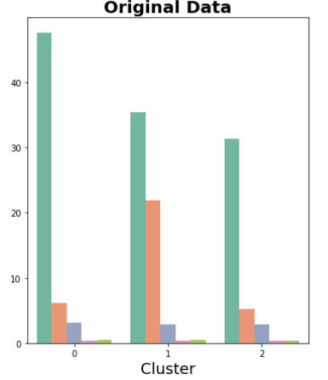

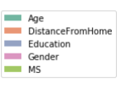

Employee
4
Modelling > Clustering
Dataset
Original non-scaled
Key Variables
Cluster 2
Age, DistanceFromHome
Cluster 0
Young
713 employees (49%)
Youngest group
Live close to the company
Old
Cluster 1
426 employees (29%)
Oldest group
Live close to the company
Middle Age
331 employees (23%)
Medium Age group
Live far away from the company

Slide 12
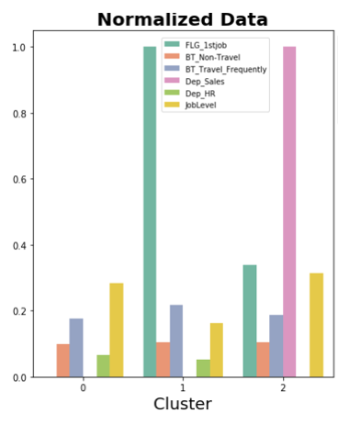



4
Modelling > Clustering
Job Position
Dataset
MinMax Normalization
Key Variables
FLG_1stJob, Dep. Sales, Dep. HR, Job Level
Cluster 1
Cluster 0
Cluster 2
Rookie Researcher
323 employees (22%)
Mainly R&D Department
Lowest Job Level
1st Job
Experienced Researcher
446 employees (30%)
Sales Department
Highest Job Level
Salesperson
701 employees (48%)
Mainly R&D Department
Medium / High Job Level
Not 1st Job

Slide 13
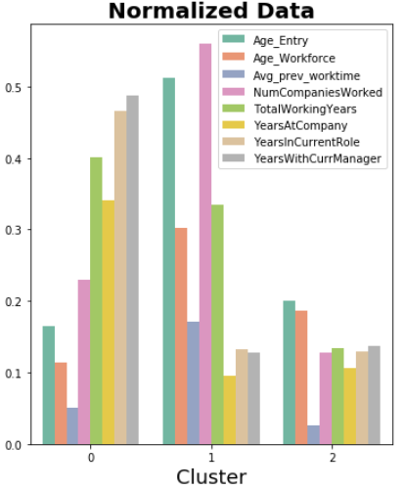



4
Modelling > Clustering
Dataset
MinMax Normalization
Key Variables
Historic Data
Age_Entry; Age_Workforce; Avg_prev_worktime; NumCompaniesWorked; TotalWorkingYears
Cluster 0
Cluster 2
Cluster 1
Senior Loyal
Work Beginners
456 employees (31%)
Entry at younger age
Highest working time at the company
Medium / low number of companies worked
539 employees (37%)
Entry at younger age
Low working years
Few number of companies worked
Frequent Changers
475 employees (32%)
Entry at older age
Lowest working time at the company
Highest number of companies worked

Slide 14
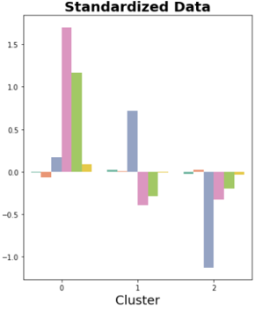
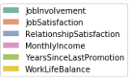



4
Modelling > Clustering
On Going
Dataset
Z-Score Standardization
Key Variables
MonthlyIncome, RelationshipSatisfaction, YearsSinceLastPromotion
Cluster 0
Cluster 2
Cluster 1
Wealthy
Unpleasant
259 employees (18%)
Highest Income
Medium relationship with peers
Promoted a long ago
497 employees (34%)
Low Income
Worst relationship with peers
Promoted in the past few years
Friendly
714 employees (49%)
Lowest Income
Very Good relationship with peers
Recent Promoted

Slide 15
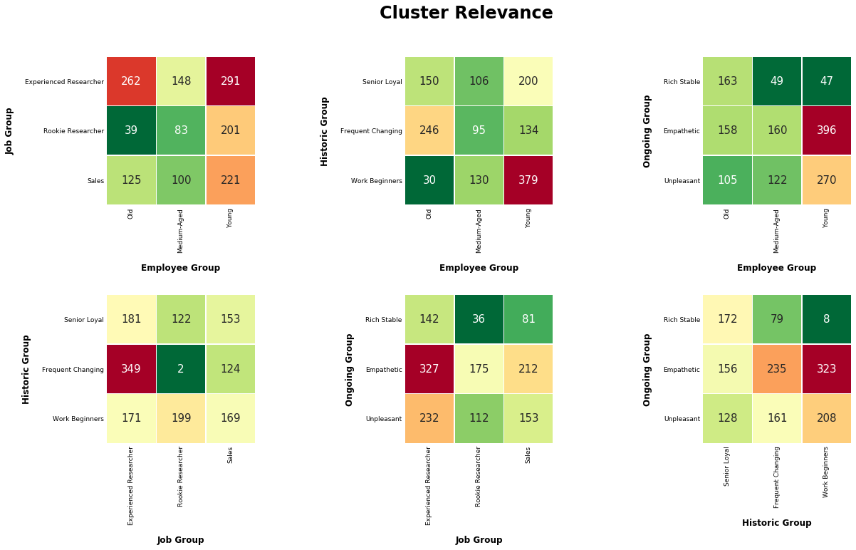
General
4
Modelling > Clustering Combinations

Slide 16








4
Modelling > Clustering - Attrition
Base attrition: 16%
From all groups presented, we can mention the following 4 as “most likely” to leave the company
Beginners – Attrition:19%
Rotative Workers – Attrition:28%
Unfriendlies – Attrition:21%
Unknown Group
Youngest workers
First job experience
Low monthly income
Good relationship with colleagues
R&D and Sales Department
Frequent job changers
Older and experienced workers
Medium monthly income
Low years in current role and with current manager
Bad job relationship with peers
Younger group
Live close to the company
High turnover
Remaining employees that couldn’t relate with any cluster and left the company as well

Slide 17
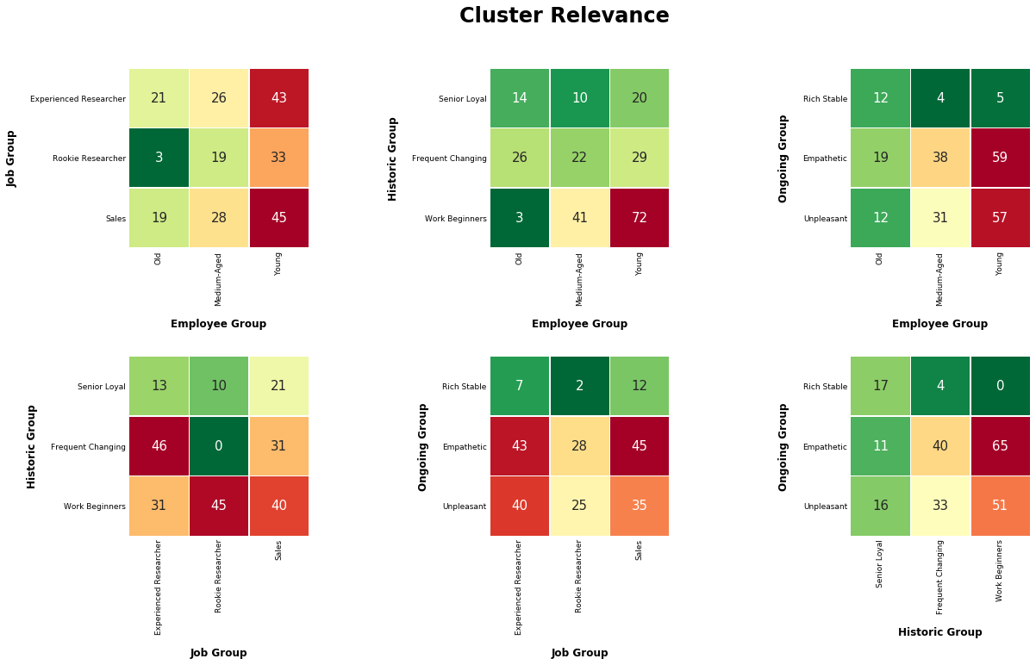
Attrition
4
Modelling > Clustering Combinations

Slide 18
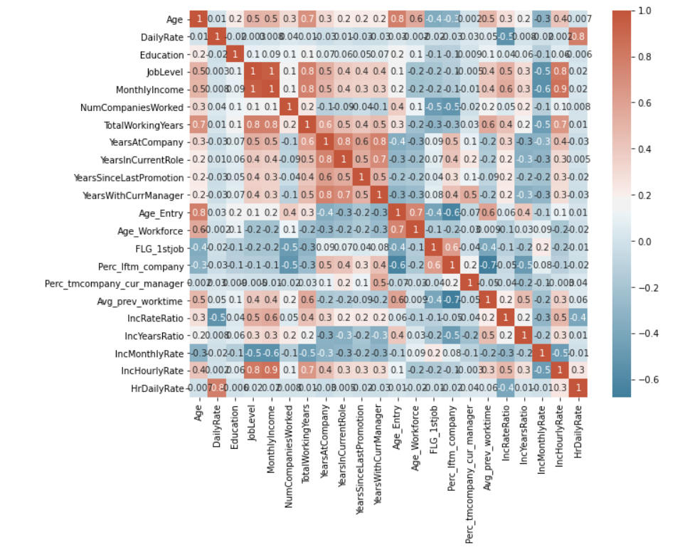

4
Modelling > Correlation
Pearson and Spearman analysis
Job Level and Monthly Income (> 0.9)
IncHourlyRate and Monthly Income (> 0.8)
YearsAtCompany and YearsInCurrentRole/YearsWithCurrManager (> 0.8)
Dropped variables
Job Level
IncHourlyRate
YearsAtCompany
‘Not fair…The company charges more for my services, and I receive the same’
Income to years at company ratio has a positive correlation with average time in previous companies
Daily Rate has no correlation to Monthly Income.
‘I’m compensated if I’ve shown loyalty to companies!’

Slide 19






an iterative process…
4
Modelling > Model Evaluation and Selection
Selected Features
Final Datasets
Model Selection
Recursive Feature Elimination
Decision Tree Feature Importance
Most Important Variables:
Monthly income
Daily and Hourly rate
Overtime
Age
Distance from home
Income to daily rate ratio
Monthly rate to income ratio
Total working years
3 types of datasets:
Data as is
Data normalized with Robust Scaler
Data normalized with MinMax Scaler
Variable nº of features of each dataset
GridSearchCV find best parameters with each dataset for Decision Tree and Neural Networks
Random Forest
Gradient Boosting
Logistic Regression
Naive Bayes
More to come…
Fine Tuning

Slide 20






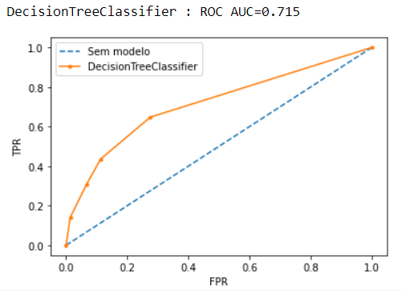
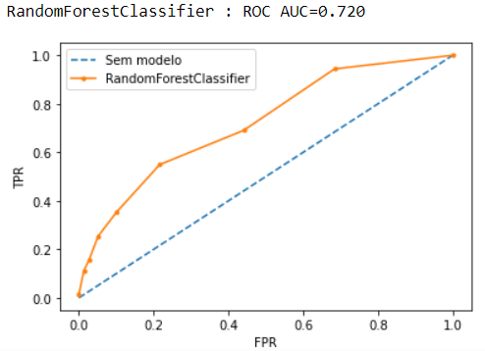
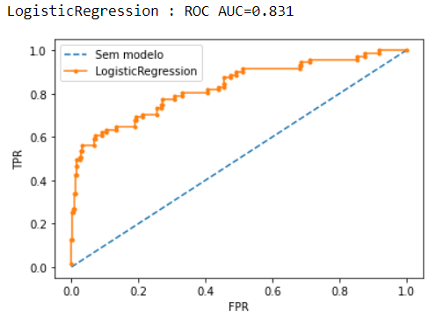
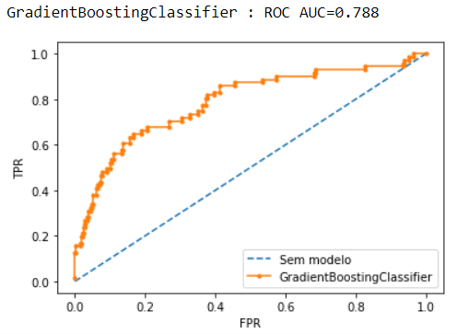
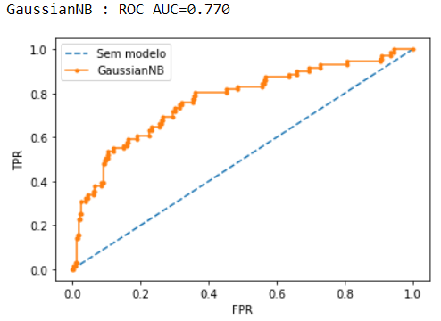
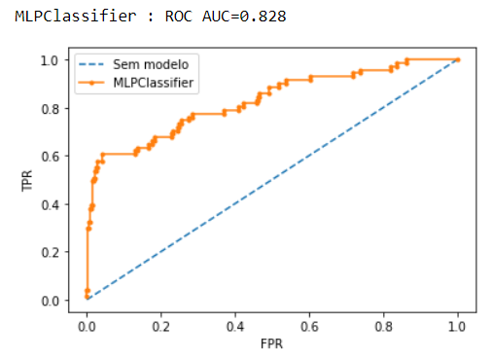
4
Modelling > Models Analysis and Results
Decision Tree
Random Forest
Logistic Regression
Gradient Boosting
Naïve Bayes Classifier
Neural Networks
Worst performer (as expected)
AUC = 0.715
Barely better than Decision Tree algorithm
AUC = 0.720
Best performer along with Neural Networks
AUC = 0.831
One of the top 3 needs parameter tunning
AUC = 0.788
Best with dataset normalized with MinMax Scaler
AUC = 0.770
Top performer with any type of dataset
AUC = 0.828

Slide 21
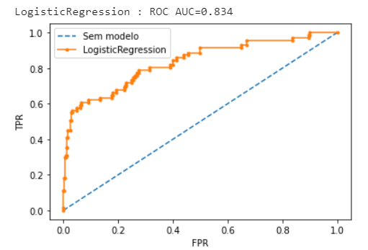
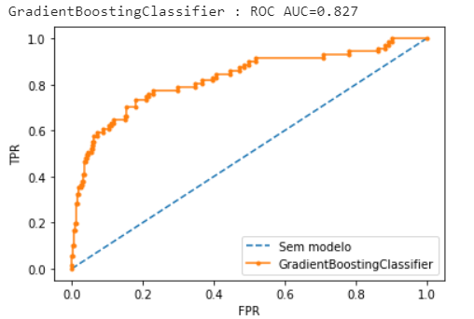
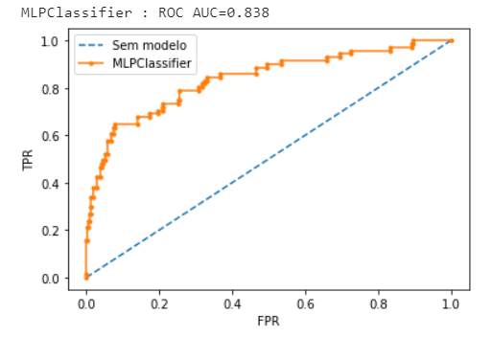
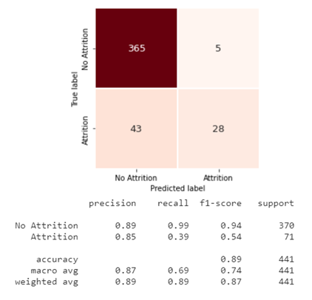
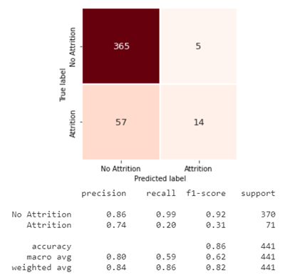
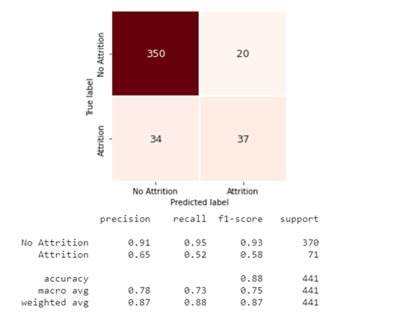
4
Modelling > Fine Tuning Best Models
All models can be really accurate when predicting no attrition, but still have some difficulties when predicting attrition (as seen by the F1 Score)
Logistic Regression
Gradient Boosting
Neural Networks
AUC = 0.831
AUC = 0.827
AUC = 0.838
Marginally Improved as parameters barely change
Biggest Improvement but it has the least precision to forecast attrition
Top performer even to predict attrition

Slide 22












Retain or not retain? There is the rub!
In case of attrition, should we retain?
‘With a higher bonus range, it’s likely that word will get out, and then everyone else will start to feel underpaid.’
Data shows that half of employees who accept a counteroffer end up leaving within 12 months
The vital few and trivial many - Pareto’s Principle
Beside income, what do the employees look for?
Firm culture, reputation, opportunities, team leader, inclusion initiatives, diversity, management’s support, promotions, training, etc.
It suggests that 20% of the workforce accounts for 80% percent of the output.
Is there a long-term retention plan for the key-employees?
Is he the one that we truly want to retain? Is he part of the 20% group?
‘I get a good sense of which folks are flight risks and then take steps to retain them, whether it’s giving them bigger challenges, removing obstacles, or even finding them a more suitable role on another team.’
‘I’m kicking myself for ignoring all the signs,’
‘This shouldn’t be a crisis. I should have had a pipeline, been more proactive about succession planning, retention—all of it.’
Should we fight to keep a star?
Notes:
The Principle is the observation (not law) that most things in life are not distributed evenly.

Slide 23
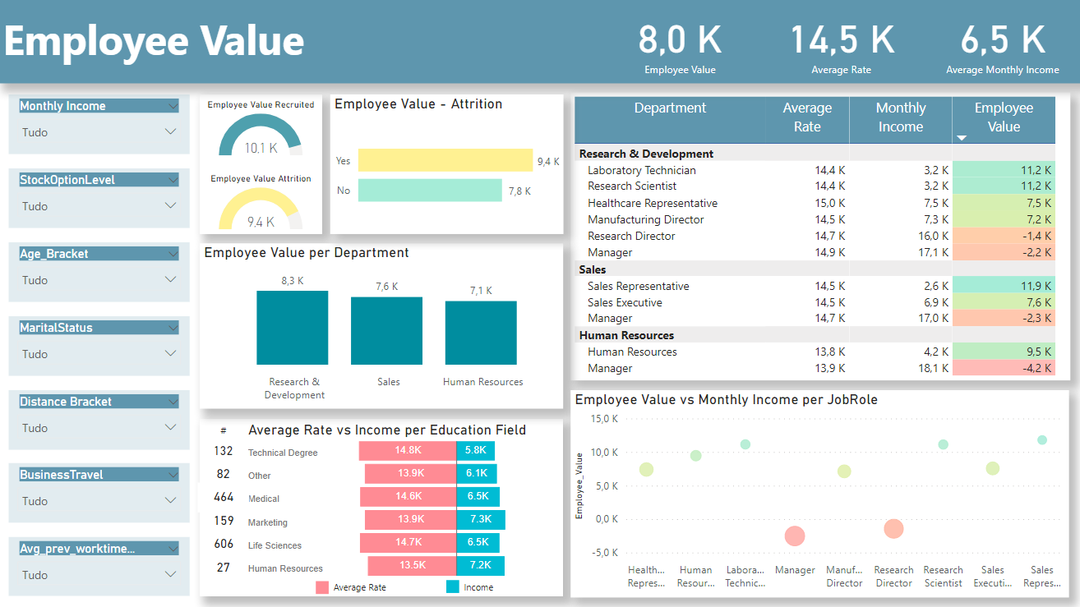
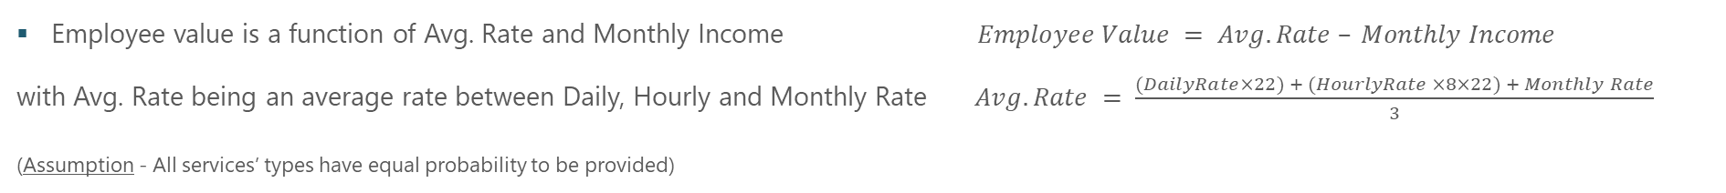
Employee Value
Employee value is a function of Avg. Rate and Monthly Income $Employee Value = Avg. Rate – Monthly Income$
with Avg. Rate being an average rate between Daily, Hourly and Monthly Rate$Avg. Rate = \frac{(DailyRate×22) + (HourlyRate ×8×22) + Monthly Rate}{3}$
(Assumption - All services’ types have equal probability to be provided)
Employees who were recruited last year present a higher Employee Value than the ones who left the company, which in turn is greater than the one verified by those who stayed
Employees with a higher Average Rate do not have a higher Income, in fact, the Education field with the greatest Average Rate is the one where the employees have a lower Income
Employees in management positions (Manager / Director) present a negative Employee Value since their Income is much higher than their Average Rate
Can we easily replace the ones who leave?

Slide 24

4
Modelling > One year in advance
Columns 52 to 25
New Dataset
Rows 1470 to 806
Trying to predict attrition 1 year ahead, there are a lot of variables we cannot use:
Variables we can use:
All year related variables, we subtract 1 year
Every employee that had YearsAtCompany equal to 0 had to be removed from the dataset – they weren’t there in the prior year
Every employee with YearsInCurrentRole, YearsSinceLastPromotion or YearsWithCurrManager equal to 0 also had to be excluded – we don’t know the reality the year before
Marital Status
Income
JobSatisfaction
…
Age & Gender
EducationField *
Department & JobRole **
NumCompaniesWorked
TotalWorkingYears, YearsAtCompany, YearsInCurrentRole, YearsSinceLastPromotion, YearsWithCurrManager
Age_Entry, Age_Workforce, FLG_1stjob
* EducationField is the only dubious variable: a person can change their primary education field over the years, by attending different course/post graduate programs throughout the years, but that’s unlikely to happen within 1 yr.
** Since the employee have to have the same manager and current role for at least one year, we can assume, the Department and JobRole stays the same, so we’re including these 2 variables

Slide 25
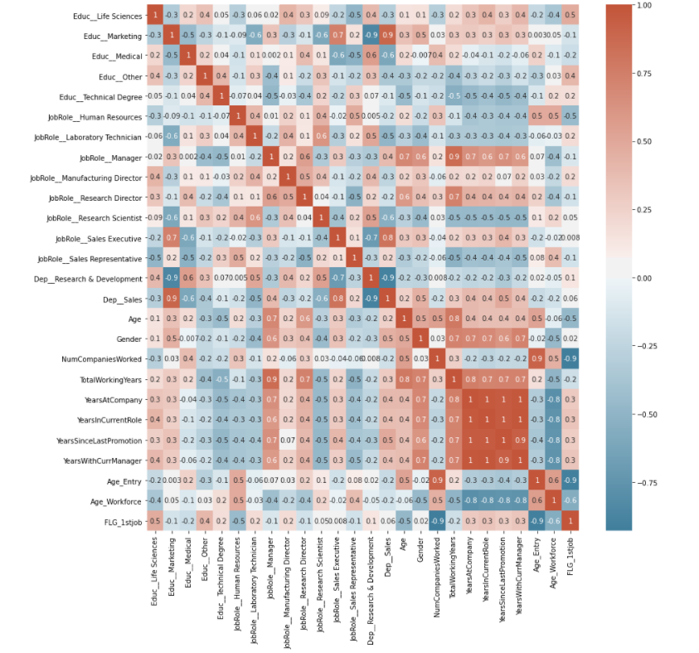
Feature Selection
4
Modelling > One year in advance
Department variables were redundant with some JobRole variables (i.e. – JobRole of Sales Executive was always part of the department “Sales”)
Spearman correlation analysis showed that a lot of the “year” variables were correlated.
Dropped variables:
Age_Entry
Dep_Research Development
Dep_Sales
FLG_1stjob
TotalWorkingYears
YearsInCurrentRole
YearsSinceLastPromotion
YearsWithCurrManager
Now working with only 17 variables

Slide 26


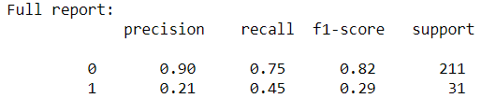

Model Fine Tuning and Selection
4
Modelling > One year in advance
Datasets
Chosen model: Gaussian Naïve Bayes, with a 13 variable dataset
2 RobustScaled (13 and 3 variables)
2 MinMaxScaled (12 and 6 variables)
Criteria:
Highest recall >> To make sure all the employees with intentions of leaving are identified
Precision isn’t as important >> we rather have a lot of false positives and improve overall employee moral with our efforts, than have a lot of false negatives and miss the opportunity to retain talent.
Accuracy: 0.7149
Precision: 0.2121
Recall: 0.4516
F1-Score: 0.2887
 | Predictions
Reality | 0 | 1 | Total
0 | 159 | 52 | 211
1 | 17 | 14 | 31
Total | 176 | 66 | 242
Models
Logistic regression
Decision Tree (2 different ones)
Neural Networks (2 different ones)
Gaussian Naïve Bayes
Random Forest
Gradient Boosting
‘Total predicted employees who will leave after 1 year is 203, with a 21% precision, that means that the model will correctly predict 42 employees that are leaving the company in one year’s time.
For a total of 806 employees, we will make effort on 25% of them to guarantee that those 5% won’t leave.’
‘With a recall of 45%, there are still 51 employees that the model will miss.
More variables (like the Income a year prior) would contribute to a higher performance model.’

Slide 27








A possible HR approach
‘Simply investing in these programs is not enough’… ‘Only drive-up expectations’
Instead of one-size-fits-all approach,
customize a personalized day-to-day experience
Most companies ask employees what they want from their work experience, but too often they stop there.
An authentic and relevant approach
Engage in one-on-one dialogues with the manager
To demonstrate a psychologically safe environment for discussions
To align expectations with transparency
To create a culture where people can bring their authentic selves to work
Employee’s hoped-for experience
Organizational
vision, resources and priorities
To ensure that everyone on his team feels valued
‘You know how much you’re valued here. We all see you as a future leader of this firm.’
Experience as flexible work policies, workplace redesigns, and learning and development opportunities
Effort
Productivity
Retention
Sources:
https://hbr.org/2020/05/case-study-should-you-fight-to-keep-a-star
Why Employee Experience Initiatives Fall Short (hbr.org)

Slide 28

Overcoming Challenges
Understanding the meaning, range and context of the dataset variables
Specifically, Hourly, Daily and Monthly Rate.
Monthly rate doesn’t equate to 22 days or less of daily rate, and daily rate doesn’t equate to 8 hours or less of hourly rate, being that the company might change the rate (by a lot) depending on the time period it’s selling the employees’ services for.
Parameters tuning and selecting the correct number of variables for the dataset to train the models
Iteration produces better results, but it’s time consuming
Difficulties in having high values for Recall in any model
Few relevant variables useful for predicting attrition in 1 year

Slide 29


Next Steps
Better and more variables:
What is the main drive for attrition?
Timestamp of the main events
Implementing the model:
Define the frequency of the model execution
Define a Control Group where no measures will be implemented (BaU) to be able to ascertain if the model is useful or not
Periodically check the model’s performance because it might deteriorate over time

